Slide 1

AIrline
PASSenger Satisfaction
CIS 412 - SEAborn Team
Ngoc Tran, Thuy Linh Luong, Long Cap, Yen Ping Choo, Xin Le Luke Goh

Slide 2
BUSINESS Understanding
Goal: Predict passenger satisfaction (satisfied vs. neutral/dissatisfied) based on flight experience features.
Key business problem: Improving customer satisfaction is critical for airlines, as it affects revenue, operational efficiency, and competitive advantage.
How Data Mining Helps: By analyzing passenger data, airlines can identify key satisfaction drivers and take targeted actions to improve customer experience.
Expected Outcomes:
Enhanced service quality
Increased customer retention
Stronger market positioning
Business Impact: Improved satisfaction will drive revenue growth, operational efficiency, and gain a competitive edge.
Notes:
Yen Ping

Slide 3
DATA Understanding
Dataset Overview
The dataset we are using comes from the "Airline Passenger Satisfaction" Kaggle dataset. It includes various aspects of passenger experiences, such as demographics, flight details, and service ratings, to help predict passenger satisfaction.
Key Features
Service-related features: Inflight wifi, seat comfort, food and drink.
Operational factors: Flight distance, delays.
Customer-related features: Age, gender, travel type.
Booking-related features: Online booking ease, check-in service.
Data Structure and Volume: Contains 24 features and over 100,000 records, providing a solid base for analysis.
Data Relationships and Quality
Features are interrelated, such as better service likely improving satisfaction. There are some missing values and potential noise, but these will be addressed during data cleaning.
Notes:
Yen Ping

Slide 4
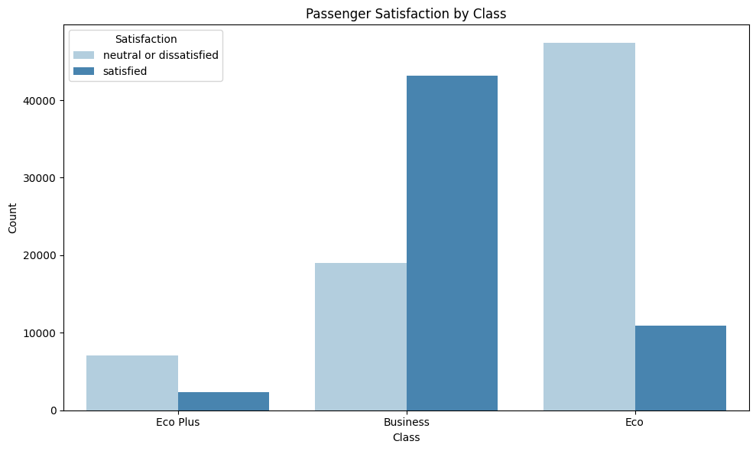
Notes:
Yen Ping
passengers in Business Class are more likely to be satisfied compared to those in Eco or Eco Plus.
higher-class services might play a significant role in passenger satisfaction, which aligns with our expectation that better services lead to higher satisfaction levels.

Slide 5
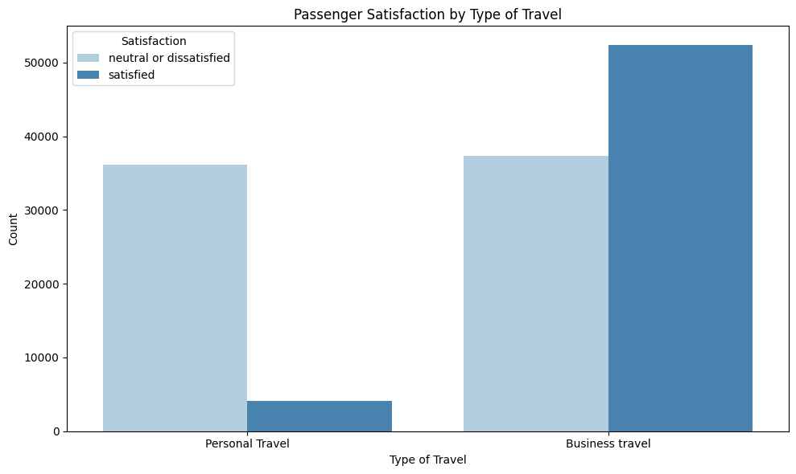
Notes:
Yen Ping
Business Travel passengers are overwhelmingly more satisfied than Personal Travel passengers.
could be because business travelers often have higher expectations or are more likely to travel under specific conditions, such as with premium services.

Slide 6
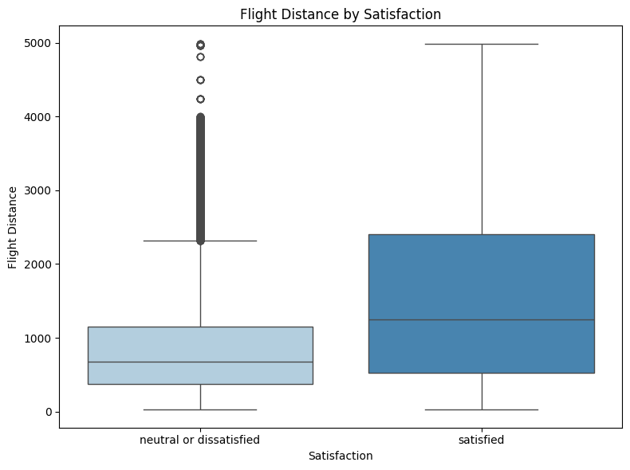
Notes:
Yen Ping
box plot comparing flight distances for satisfied versus neutral/dissatisfied passengers.
passengers who were satisfied tend to have shorter flights, while those who were dissatisfied often traveled longer distances.
suggest that long flights may contribute to dissatisfaction, especially if service quality is not up to expectations.

Slide 7
DAta Preparation - Cleaning
02
04
01
03
Merge test.csv and train.csv into 1 dataframe
Drop unnecessary columns like serial and id
Make sure columns are in the right data types
Fill in missing values for ‘Arrival Delay in Minutes’ with mean
Notes:
Linh

Slide 8
Data Preparation - Preprocessing
Encoding predictors
Using get_dummies
Encoding Target Variable
Using LabelEncoder
Split Data into train and test
Using train_test_split with test_size = 0.2
Notes:
Linh

Slide 9
Classification Models
The goal is to predict whether a passenger is satisfied OR neutral or dissatisfied based on various features related to their flight experience
Our 2 chosen models:
⭐Logistics Regression
⭐Decision Tree
Notes:
Long

Slide 10
Why LOgREG and Tree?
Logistics Regression
Simple and fast
Easy to interpret
Good baseline model
Sensitive to outliers
Struggles with complex patterns
Decision Tree
Easy to visualize and explain
Handles both numeric and categorical features
Robust to outliers
Can overfit if not pruned
Less stable (small changes in data can change the tree)
Notes:
Long

Slide 11
Comparing features importance of 2 models
Logistics Regression
Decision Tree
 | Odds
Online Boarding | 2.041192
Inflight wifi service | 1.393497
Inflight entertainment | 1.381107
On-board service | 1.193943
Leg room service | 1.163094
 | Importance
Online Boarding | 0.304045
Inflight wifi service | 0.192439
Type of Travel_Personal Travel | 0.134357
Inflight entertainment | 0.066696
Customer Type_disloyal Customer | 0.044070
Notes:
Long
Here we compare feature importance between Logistic Regression and a Decision Tree. Both models highlight Online Boarding as the top driver, but Logistic Regression focuses more on service features like WiFi and entertainment, while the Decision Tree also captures behavioral factors like travel type and loyalty. This tells us that improving digital services is key, but customer segments matter too. Using both models gives us a balanced view—combining service upgrades with targeted strategies.

Slide 12
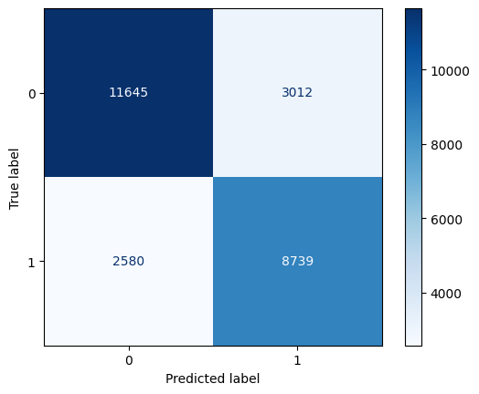
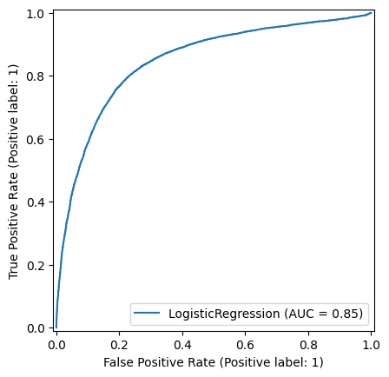
Logistics Regression
Confusion Matrix
Accuracy on the training set: 0.7851
Accuracy on the test set: 0.7847
ROC Curve
Notes:
Long
The accuracy on the training set is about 78.5%, and the accuracy on the test set is very close at 78.4%, showing that the model generalizes well without overfitting.
On the top right, you can see the confusion matrix, which shows the model correctly predicted a large number of both positive and negative cases, though there are still some misclassifications.
Below that is the ROC curve, with an AUC score of 0.85, indicating that the model has good performance in distinguishing between the two classes.

Slide 13
Original Decision Tree
Accuracy on the training set: 1.0
Accuracy on the test set: 0.9478
Notes:
Linh

Slide 14
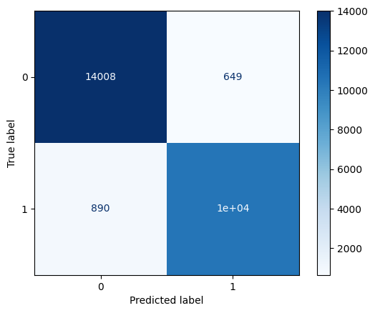
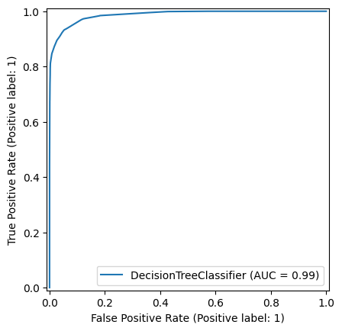
Gridsearchcv Decision Tree
Confusion Matrix
Accuracy on the training set: 0.9421
Accuracy on the test set: 0.9408
From GridSearch algorithm, the best tree has the max_depth = 11 and max_leaf_nodes = 49
ROC Curve
Notes:
Linh

Slide 15
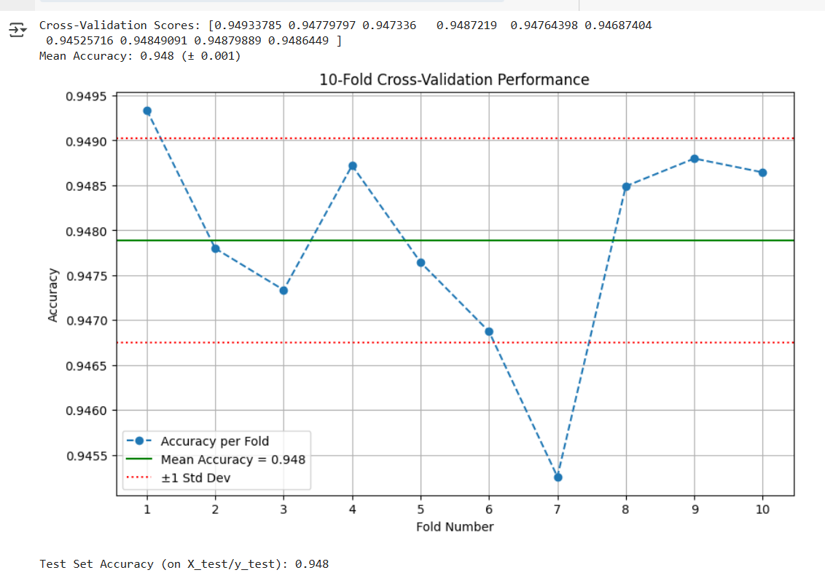
Model Improvement - Cross Validation
Method: 10-fold CV (shuffled, random_state=0) on decision tree.
Mean CV accuracy: 0.948 ± 0.01. All 10 folds show very similar accuracy (0.945–0.949). Tiny standard deviation (±0.001) → Model performance is stable regardless of data splits.
Test accuracy: 0.948 (aligned with CV). No overfitting; generalizes perfectly to unseen data.
Per-fold accuracy (blue line) ±1 std dev (red dashes). Low variance → model generalizes well.
Notes:
Luke
We employed Cross-validation for stress test for our decision tree model. Instead of checking performance once, we test it 10 different ways. Your results show the model isn’t just lucky—it’s consistently accurate, which is why we trust it.
Our CV results show exceptional consistency—all folds hover near 94.8% accuracy with almost no variance. The test set matches this exactly, confirming our model’s reliability. This level of stability is ideal for deployment.

Slide 16
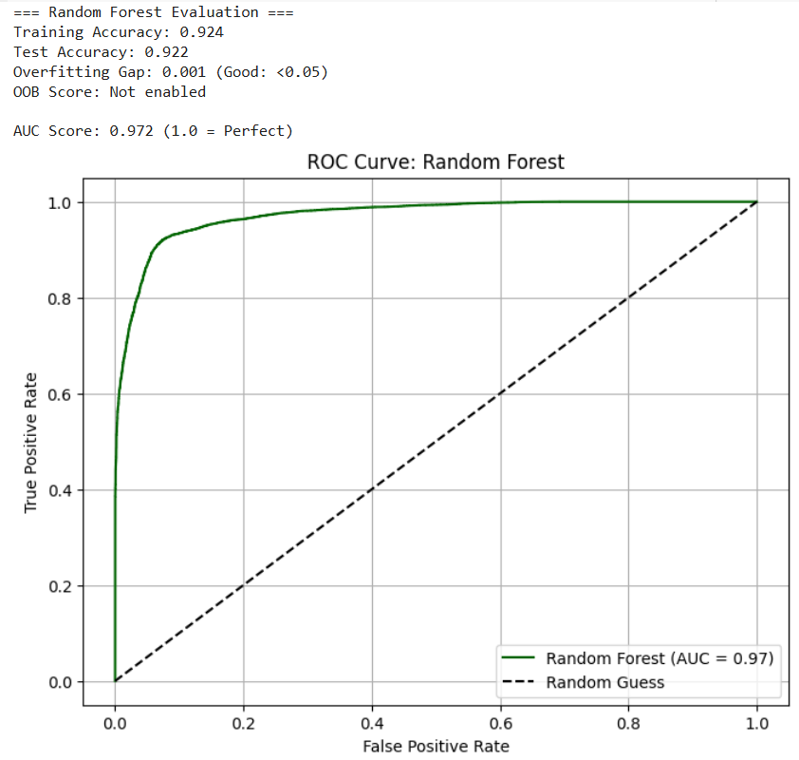
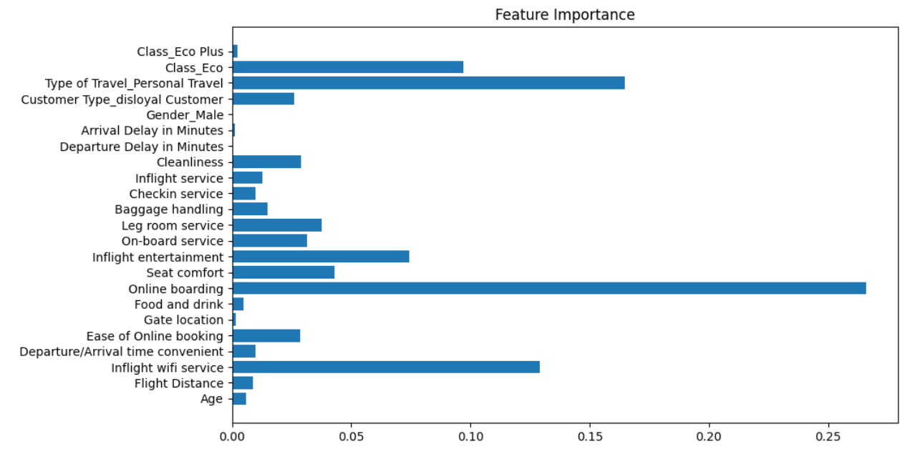
Random Forest
Notes:
Luke
Random Forest isn't just another algorithm—it's a precision tool for fixing common modeling flaws. Here's how it elevates the performance of our model:
Accuracy Scores: "The model achieves 92.4% training accuracy and 92.2% on the test set—a negligible gap of just 0.001. This suggests excellent generalization with no overfitting."
AUC-ROC: *"With an AUC score of 0.972, our model significantly outperforms random guessing. The ROC curve shows strong separation between classes—nearly ideal for real-world deployment."*
Feature Importance: "The horizontal bar chart reveals which features drive predictions most."

Slide 17
DEployment plan
Goal: Predict whether a passenger is Satisfied, Neutral, or Dissatisfied based on flight experience factors
Actionable Deployment Plan for the Airline:
Short-Term (1–3 months)
Identify dissatisfied passengers immediately after flights using the model
Send apology emails, discounts, or feedback requests to those flagged as dissatisfied
For neutral passengers, offer loyalty incentives to improve retention
Improve digital services like online boarding and inflight WiFi (top features in both models)
Launch a customer service protocol triggered by predictions (e.g., high-priority follow-up)
Long-Term (3–12 months)
Use weekly batch analysis to find underperforming flight routes or services
Invest in service upgrades where dissatisfaction is consistently high (e.g., WiFi, seat comfort)
Personalize promotions: e.g., special offers to disloyal or personal-travel passengers identified by the Decision Tree
Use satisfaction trends to inform staff training and route-specific management decisions
Notes:
Tisa

Slide 18
DEployment plan
Ethical Considerations
Fairness: Ensure the models don’t introduce bias based on travel class, gender, or loyalty status. Conduct regular fairness audits
Privacy & Compliance: Encrypt personal data in transit and at rest. Follow GDPR, CCPA, and airline-specific data protection regulations
Transparency: Use interpretable models. Explain key decision factors (e.g., online boarding score, travel type) to both staff and passengers if needed
Human Oversight: Ensure staff can review and override model decisions. Use predictions to support—not replace—human judgment
Notes:
Tisa

Slide 19
DEployment plan
Risk | Mitigation
Model Drift | Retrain every 6 months or after major changes
Privacy Breach | Encrypt data, audit systems regularly
Overreliance | Train staff to use predictions as guides, not absolute
Downtime | Cloud auto-scaling, backup servers, failover plans
Notes:
Tisa

Slide 20
THank you

